Slide 1

SAP Analytics cloud training
Anubhav Oberoy
Day 9

Slide 2
Agenda – Day 9
Understanding advance Designer Concepts
Working with Scripting Hierarchies
Transfer Context
Integrate Stories
www.anubhavtrainings.com

Slide 3

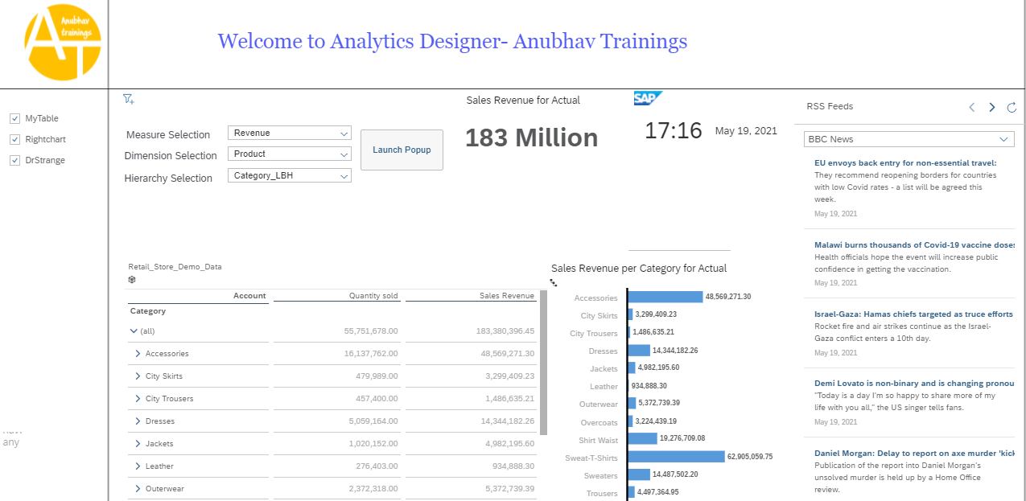
Creating Analytic Designer Application
www.anubhavtrainings.com

Slide 4
End of Day 9

Slide 5

Questions

Slide 6

Anubhav Oberoy
anubhav.abap@gmail.com

